Slide 1

MENTAL Health & BURNout workplace analysis
Aaron Tan
Mini-Project 3
#2025-07-08-ds-pt-wa-sg

Slide 2
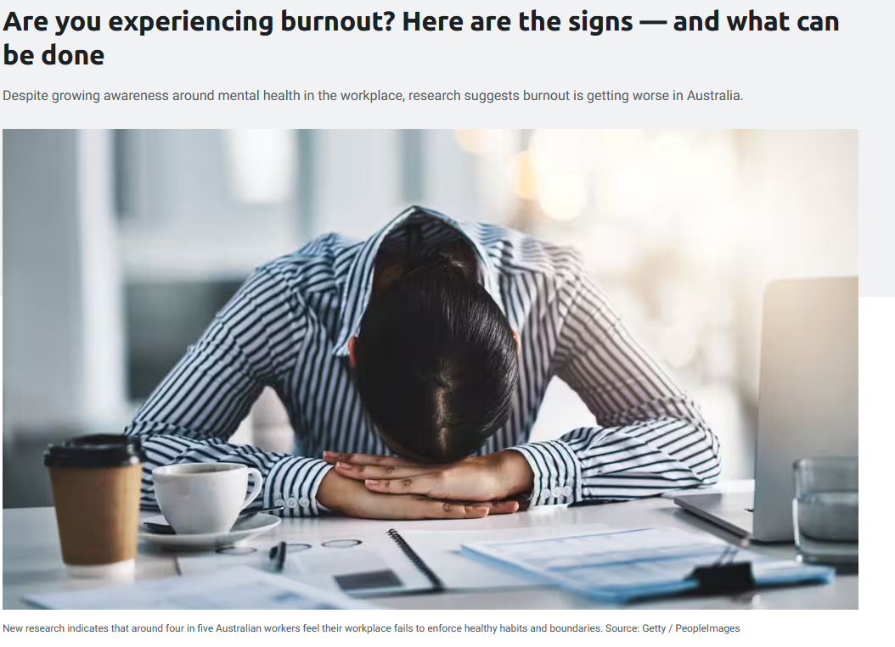
Article
💀 Chronic Exhaustion: Persistent physical, emotional, and mental fatigue - even after rest - leading to low energy and constant tiredness.
🧠 Mental & Emotional Strain: Increased irritability, cynicism, detachment from work, and feeling overwhelmed or “checked out.”
📉 Declining Performance: Reduced focus, slower thinking, procrastination, and feeling ineffective or unable to keep up with workload.
Statistically: estimated nearly 3M Australians are likely to consider leaving their job in the next year

Slide 3
Agenda
Intro
Audience
EDA
Workflow
Recommendations

Slide 4
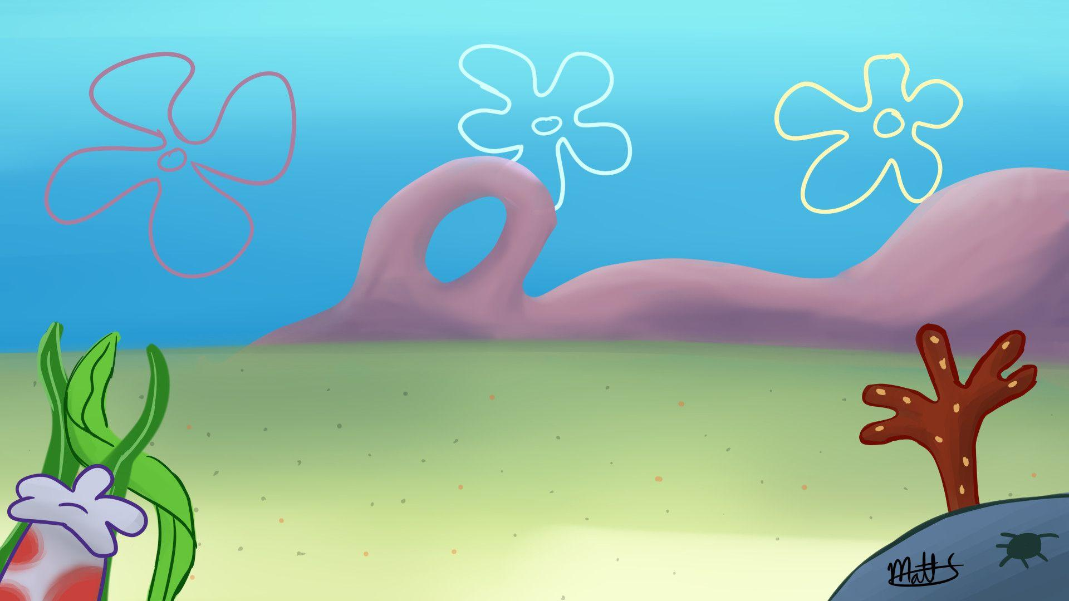
Introduction
Work/Values Quiz: What Drives You Most at Work?
Which of these you resemble the MOST?
A. I love getting things done and don’t mind tough or intense workloads - I just keep going!
B. Financial stability matters most to me - I’ll push through hard work if it means better income.
C. I enjoy challenging myself mentally to solve problems, but I still want a workload that keeps me balanced.
D. I prioritise sleep, rest, and my wellbeing - I won’t sacrifice peace just for work.
E. I want control and autonomy, but only when it fits my energy levels and doesn’t overwhelm me.
NOTE: REMEMBER WHICH OPTION YOU SELECTED

Slide 5


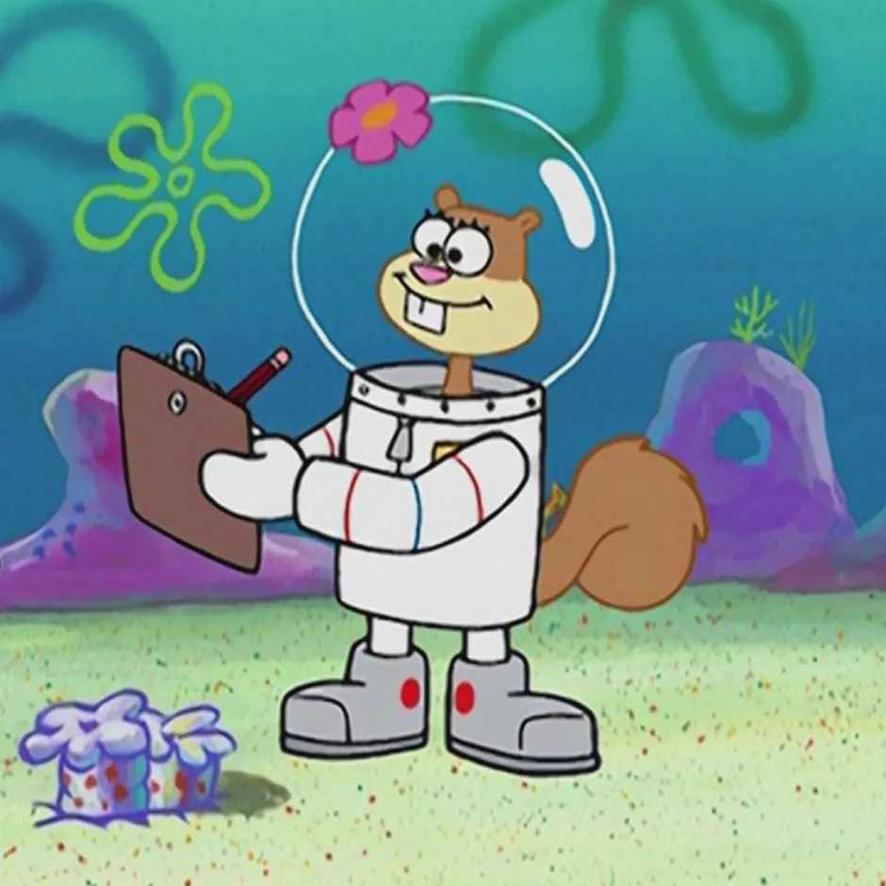

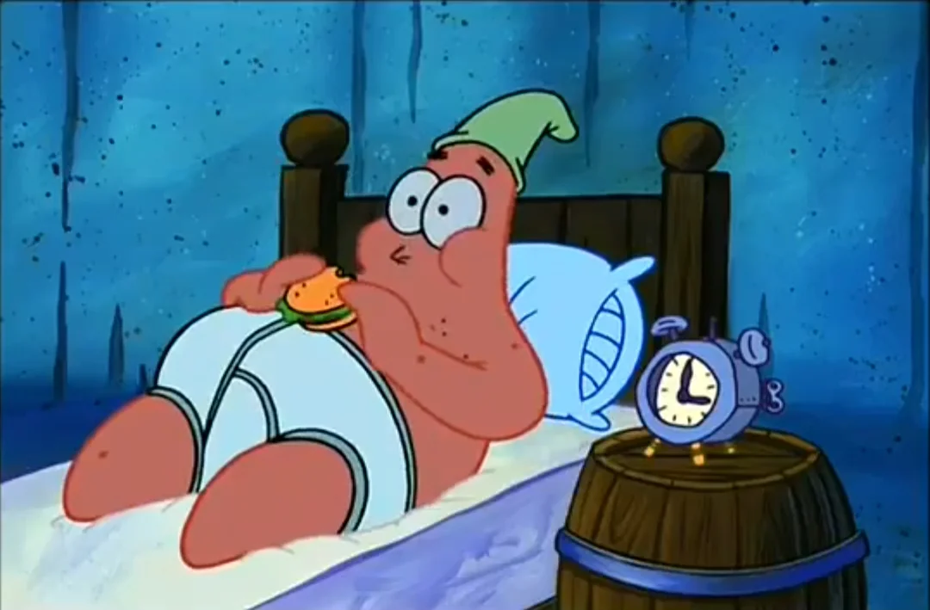
Introduction
Spongebob Personality Insight: Your Results
Which of these you resemble the MOST?
B: Money
A: Work Drive
C: Problem-Solver
E: Control/Autonomy
D: Work/Life Balance

Slide 6

Introduction
Main Point?
Each character reveals a unique burnout pattern. The question is - can these patterns be grouped to help us recognise high-risk workers before burnout occurs?
Sample Risk Example:
Group | Occupation | Risk?
A | ICU Nurse | High
B | FIFO | High
C | Unicorn Engineer | High
D | Admin Officer | Low
E | Freelancer | Low
A. I love getting things done and don’t mind tough or intense workloads - I just keep going!
B. Financial stability matters most to me - I’ll push through hard work if it means better income.
C. I enjoy challenging myself mentally to solve problems, but I still want a workload that keeps me balanced.
D. I prioritise sleep, rest, and my wellbeing - I won’t sacrifice peace just for work.
E. I want control and autonomy, but only when it fits my energy levels and doesn’t overwhelm me.

Slide 7

Audience
Stakeholder: Beyond Blue
Public Mental Health & Wellbeing Organisation
Increasing urgency to address rising rates of workplace stress and burnout across Australia.
Promote early identification of burnout symptoms to prevent escalation into anxiety, depression, or long-term psychological injury.
Support integration of evidence-based tools and AI-assisted risk assessments to help organisations detect burnout early.
Build public trust in digital mental health solutions by ensuring they are safe, ethical, and grounded in clinical research.

Slide 8
Audience
Why this problem worth investigating?
🧠 Burnout is becoming one of the most common workplace challenges worldwide, affecting productivity, wellbeing, and long-term career health.
⚠️ Early signs are often ignored — chronic stress, exhaustion, and emotional detachment tend to build up slowly until performance and mental health decline sharply.
💻 Workload pressure, constant digital communication, and unrealistic expectations overwhelm employees and reduce their capacity to recover.
📊 Data shows burnout leads to reduced output, higher absenteeism, turnover, and long-term health issues, costing organisations billions annually.
🌍 Addressing burnout early creates healthier workplaces, improves employee satisfaction, and supports sustainable long-term performance and wellbeing.

Slide 9
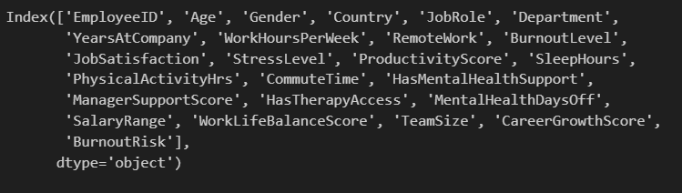
EDA
3000 records | 25 features 🧠 Goal: Explore 25 data features to find clusters of employees who share similar traits — and identify which groups are most prone to burnout.

Slide 10
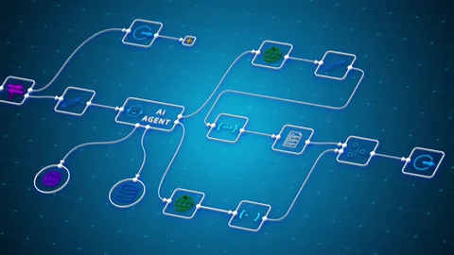
WORKFLOW

Slide 11
Workflow Overview
1. Pipeline (High-Level) Agenda
1. Unsupervised Models Numerical Evaluation
2. NLP + Unsupervised Models LLM Generated Descriptions & Evaluation
3. Clusters Conclusion Insights and Final Interpretation

Slide 12
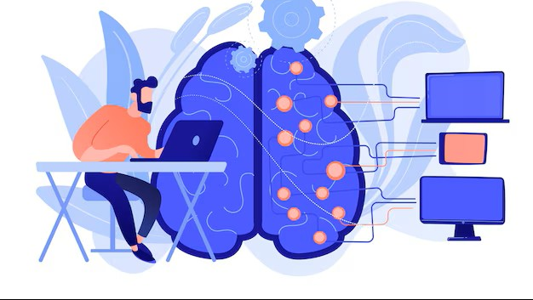
UNSUPERVISED MODELS

Slide 13
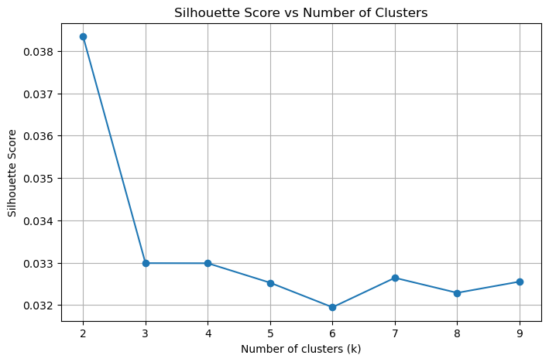
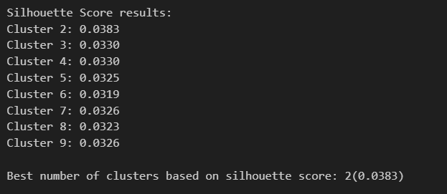
Unsupervised Models
1. Evaluation Results – Silhouette Score
Silhouette Score calculated between range k=2-9
K=2 (0.0383)
Meaning that demonstrating 2 clusters provides the best separation and cohesion of this dataset.
⚠️However, the overall Silhouette Scores are very low, suggesting that the dataset does not naturally form strong clusters using numerical features alone.

Slide 14
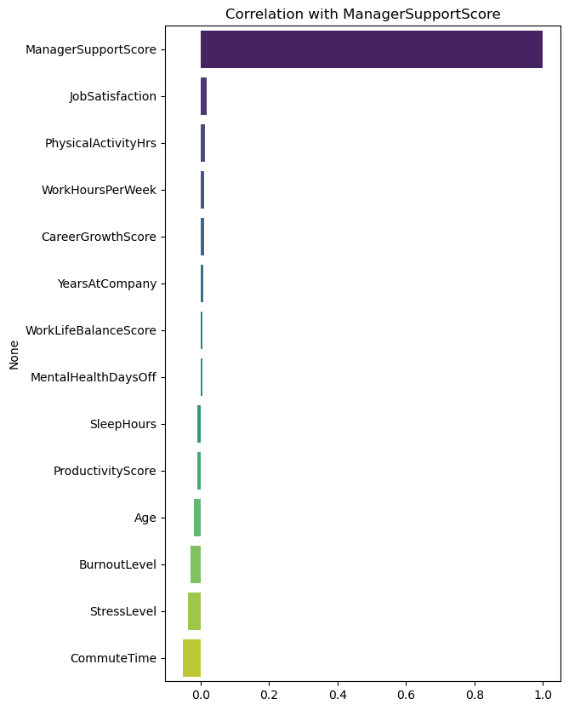
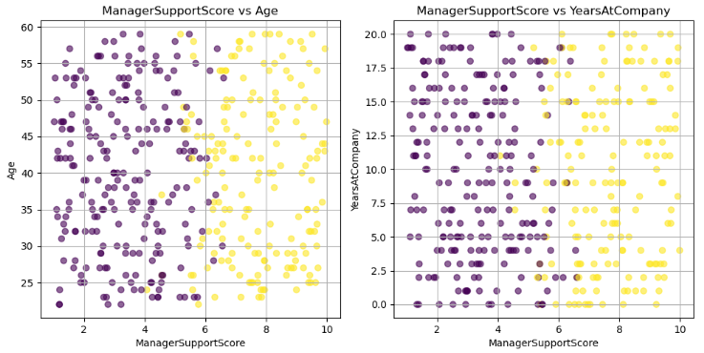
Unsupervised Models
2. Evaluation Results – Correlation Results
Across all numerical features, ManagerSupportScore was the only variable that showed any meaningful separation between groups.
Scatterplots (example: Age vs ManagerSupportScore) show no clear structure or cluster patterns in the other features.
⚠️ Limitation: Synthetic Data Quality
Unsupervised clustering was not effective because numerical datapoints are synthetic, meaning the values were randomly generated without real-world patterns.
Clustering to determine any burnout risks purely on numerical without NLP is not valid for this dataset.

Slide 15
NLP + UNSUPERVISED MODELS

Slide 16

LLM Generated Descriptions
1. Purpose LLM-Generated Descriptions
WHY generate LLM Descriptions?
Because the dataset contains no written employee feedback, an external LLM was used to generate synthetic descriptions. This provides the text needed for NLP analysis and cluster evaluation.
These descriptions simulate what an employee might write about their work experience and burnout, allowing us to apply NLP-based clustering and uncover patterns that numerical data alone cannot provide.
❗Disclaimer: Groq LLM descriptions are artificial and should not be interpreted as real human opinions or experiences.
LLM Generated example:
As a 10-year veteran in the Customer Support role, I feel overwhelmed by the excessive demands and stress (2.61) that has pushed my burnout level to 4.26, affecting my overall wellbeing.
Despite having access to therapy, I often find it challenging to maintain a healthy work-life balance, especially with a 60-minute commute and only 7.3 hours of sleep daily.
My ManagerSupportScore of 2.93 and SalaryRange of 40K-60K fail to offset the dissatisfaction I feel in my job, further impacting my wellbeing and causing mental health days off.
Model: llama-3.1-8b-instant

Slide 17
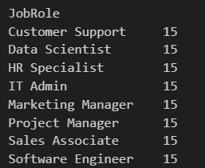
LLM Generated Descriptions
2. EDA
🧠120 records | 25 same data features
15 sample for each JobRole (total of 8 Unique JobRoles)

Slide 18
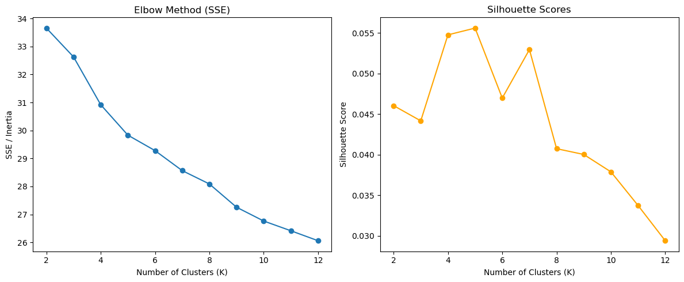
NLP + Unsupervised Models
3. Evaluation Results – SBERT
Optimal K (Silhouette Score): 5
SSE = 29.83,
Silhouette: 0.0556
SBERT means a model for evaluating semantic meaning and similarity.
Based on these results, k=5 provides the best clustering structure for the SBERT embeddings.
The Silhouette Score indicates a mild level of cluster separation, meaning there is some semantic grouping, but the clusters are not strongly distinct.

Slide 19
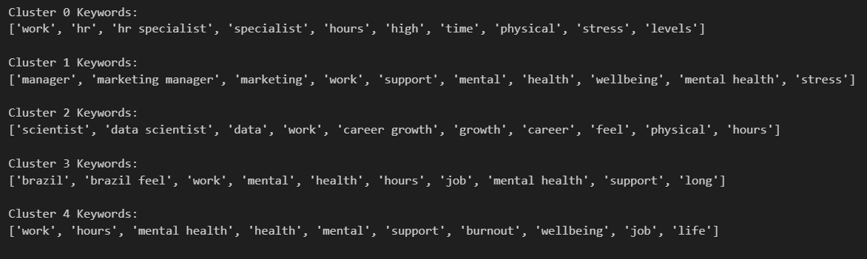
NLP + Unsupervised Models
4. Clusters Keywords Results
Each cluster was able to discover meaningful and similar keywords based on human interpretation themes alone such as: HR, mental health, Brazil etc.
SBERT successfully grouped semantically similar descriptions, showing mild but meaningful thematic separation.

Slide 20
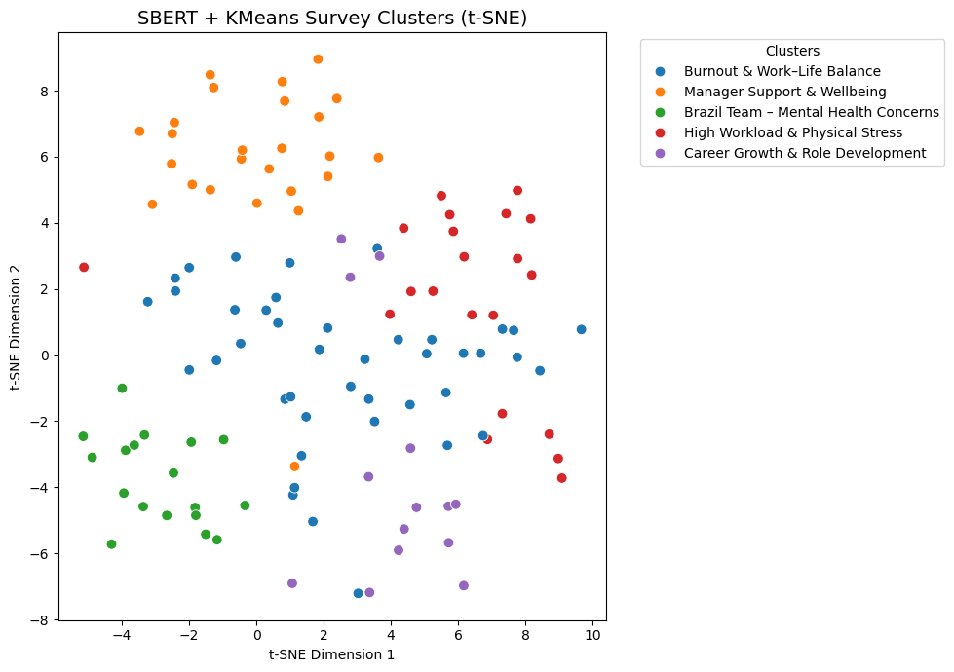
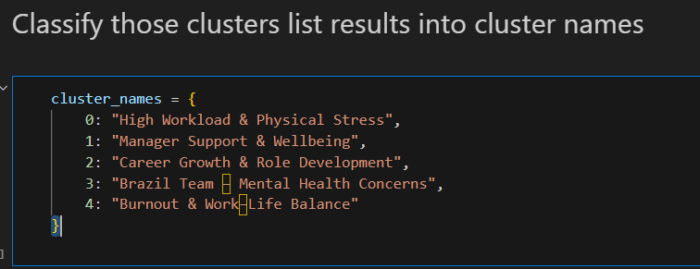
NLP + Unsupervised Models
5. Clusters Naming and Visualisation Separation

Slide 21
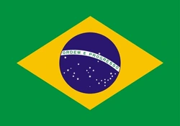

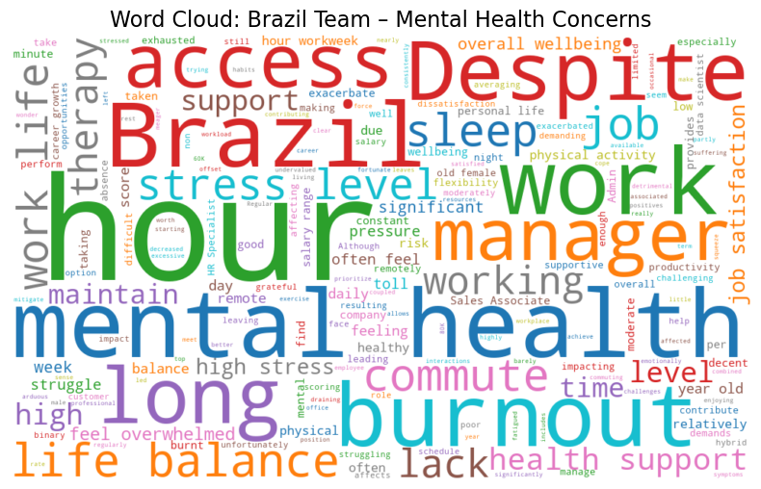
NLP + Unsupervised Models
6. Word Cloud Cluster Example: Brazil Team – Mental Health Concerns
This cluster suggests that the Brazil team frequently expresses themes of burnout, mental health strain, long hours, and limited support, indicating elevated wellbeing concerns.

Slide 22
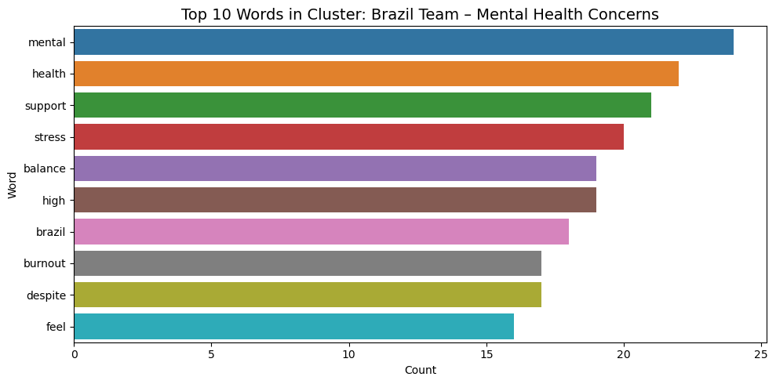
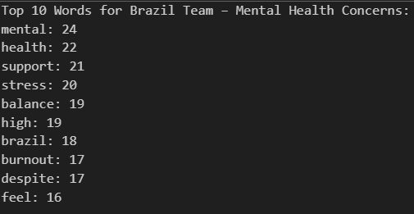
NLP + Unsupervised Models
7. Deeper Analysis: Brazil Team – Mental Health Concerns
Insight: This cluster shows that the Brazil team frequently uses terms related to mental health, stress, burnout, and limited support, suggesting elevated wellbeing challenges.
Cluster Meaning: These keyword patterns indicate a potential regional hotspot for burnout, requiring targeted support and workload assessment.

Slide 23
CLUSTERS CONCLUSION

Slide 24
Clusters Conclusion
1. Insights and Final Interpretation NLP + Unsupervised
Based on the clustering results, we have identified 5 clusters that are more likely to experience significant burnout within the workplace, and these groups are important to monitor to evaluate employee’s work health being.
Cluster | Meaning | Key term Example
🔥 High Workload & Physical Stress | Heavy workloads and long hours creating physical/mental strain. | HR
👥 Manager Support & Wellbeing | Stress tied to lack of manager support and emotional wellbeing. | Stress
📈 Career Growth & Role Development | Pressure to grow quickly and keep up with workload expectations. | Growth
🌎 Brazil Team – Mental Health Concerns | Strong language around fatigue, stress, and emotional strain. | Brazil
⚖️ Burnout & Work-Life Balance | Direct mentions of burnout, poor balance, and mental health issues. | Burnout

Slide 25
Recommendations
Recommendations Agenda
1. Model Impact
2. Why it matters ⚠️Case Study Example
3. Stakeholder Action Plan
4. Future Improvements & Limitations Awareness

Slide 26

Recommendations
Model Impact
Model Impact – NLP Clustering Detection
Identifies early burnout risks by analysing patterns in employee narratives.
Reveals clear thematic groups (e.g., workload, manager support, mental health) that are easy for HR to interpret.
Helps leadership target support strategies toward specific high-risk clusters.
Improves wellbeing resource allocation by showing which teams or regions need attention.
Supports data-driven decision-making for long-term workplace health improvement.

Slide 27

Recommendations
Why this matters?
🌍 Real-World Importance Burnout is one of the leading causes of reduced productivity, turnover, and long-term mental health decline in workplaces worldwide. Many employees never report early symptoms, meaning organisations often react too late.
📊 Early Detection = Better Outcomes By identifying high-risk clusters early, companies can intervene before burnout escalates—improving wellbeing, reducing absenteeism, and preventing costly staff turnover.

Slide 28
Recommendations
Why this matters?
⚠️ What Happens If We Don’t Implement It?
Late Detection = Higher Burnout & Turnover
Without early identification, employees reach severe burnout before anyone notices - leading to resignations, absenteeism, and long-term mental health issues.
Lost of Confidence & Career Decline
Employees may lose confidence in their career path, feel unsupported, and develop worsening stress or depression over time.
Without AI insights and early detection, hidden burnout causes even top talent to leave the profession - leaving leaders frustrated and struggling to find the high-quality people their business depends on.

Slide 29

Recommendations
Case Study: Google Project Oxygen
A senior software engineer at Google had been leading a time-sensitive infrastructure project. Months of high workload, on-call stress, and limited managerial support began to take a toll.
This leads to the following consequences:
The project’s launch was delayed by 6–8 weeks.
Leadership couldn’t find a replacement with matching expertise.
Team morale dropped, creating more stress for remaining engineers.
Why This Matters?
💰 Replacement cost > $300K-$500K
🔄 Time to replace Senior talent: 60 - 90 days
📉 Innovation slows down – team output can drop 20-40% after losing a key performer

Slide 30
Recommendations
Stakeholder Plan
Beyond Blue
Action 1: Policy and Workforce Wellbeing Strategy
Beyond Blue can use these insights to help all industries recognise which employee groups face the highest burnout risk.
This supports the creation of targeted wellbeing programs, early-intervention policies, and national mental-health guidelines.
Action 2: Targeted Intervention Support
Deliver targeted support to the most vulnerable groups and maintain ongoing wellbeing checks across all staff to prevent burnout before it becomes severe.

Slide 31

Recommendations
Future Improvements
Improvements suggestions:
Build a simple MVP (Minimum Viable Product) to visually demonstrate insights and present a compelling proof-of-concepts (POCs) to consolidate better awareness of this project’s vision.
Explore additional clustering methods and apply stronger statistical validation to improve reliability.
Deepen analysis by refining feature engineering and confirming which variables and keywords most strongly drive burnout.

Slide 32

Recommendations
Limitations
Limitation Awareness:
The dataset is small and synthetic, which limits how well the findings generalize and may detect missing groups to real workplaces.
Only 120 rows of NLP text were generated due to LLM and hardware constraints, reducing depth and diversity of insights.
Real employee data and expert validation are needed to confirm accuracy and prevent misleading conclusions.
No valid clusters were detected in the numerical data, making it difficult to identify reliable features causing an ineffective way to build an MVP for a simulated app.

Slide 33
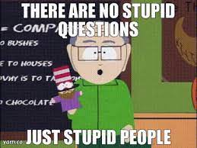
Questions?

